Slide 1

LAND PRICE PREDICTOR
Supervised by:
Mr. Armughan Ali
Group Members:
Muhammad Abdullah Waheed (FA17-B CS-028)
Ibtisam Zubair (FA17-BCS-065)
Department of Computer Science
COMSATS University Islamabad, Attock Campus

Slide 2
Outline
Introduction
Problem statement
Objectives
Methodology
Comparison Table
Modern tools
Benefits
Diagrams
Application Screenshots
Conclusions
References

Slide 3
Introduction
For many people, buying a property is one of the most important decision and purchase in life. Some people invest their whole life’s savings on this and some people buy the property in hustle and necessitation.
Now-a-days fraud is so common in this field. Experts and marketers can easily make simple and lay people fool in this situation.
So we will design a mobile application which predicts the land price of different areas based on machine learning concepts.
It will predict the price for about 10 years based on their facilities, location and crime rate using machine learning algorithms. Also the plot dimensions and orientations are included.
It will applicable in commercial use as well as domestic use.

Slide 4
Problem statement
Now-a-days purchasing of land/plot is a major issue because fraud is very common in our society.
Future price prediction of a land for a normal or lay person is very difficult.
The main problem is how to automate the most precise Prediction process.

Slide 5
Objectives
An android based land pricing prediction app.
To save people from fraud and scam.
We’ll use machine learning algorithms to get maximum precise prediction
Provides an effective way to predict the future importance of land according to past and present price difference and resources.
Will provide ease in domestic as well commercial use.
People can find the suitable land according to their need and budget on their smartphone.

Slide 6
Methodology
In the whole project, we use Agile Methodology (Requirements, Design, Develop, Test, Deploy and Review).
For backend development, we’ll use the Machine learning algorithm i.e. “Multivariable Linear Regression” which will predict the price using the data set given to it.
For frontend development, we use Android Studio and Java programming.
To connect Frontend with Backend, we’ll use python and android API.

Slide 7
Related Work/Comparison Table
Company | Type | Future Price Prediction | House/Land | Standard/Local Currency rate
Machine Learning for London Housing Price Prediction Mobile Application | Android | Yes | House | Local
Check Land Prices | Android | No | Land | Local
Zillow | Android/Web | No | House | Standard
Zameen.pk | Android/Web | No | Both | Local
Land Price Predictor | Android | Yes | Land | Standard

Slide 8
Modern tools
Java Programming Language (Building block for android programming)
Android Studio & SDK (Designing and Development)
SQL (Knowledge of Basic Queries)
Basic concepts of python (For machine learning)
Learning algorithms for Machine Learning.
Pycharm (For implementation of Machine Learning algorithms using python)
A smartphone (For testing)

Slide 9
Benefits
Predict accurate price of land for next 10 years.
Save time and efforts related to dealing of land.
To provide users a free application.
To specially help older citizens and women who are at home and can’t go outside for buying a land.
To save amateur people from fraud.
The factor of ROI (Return on Investment) will be the first priority.

Slide 10
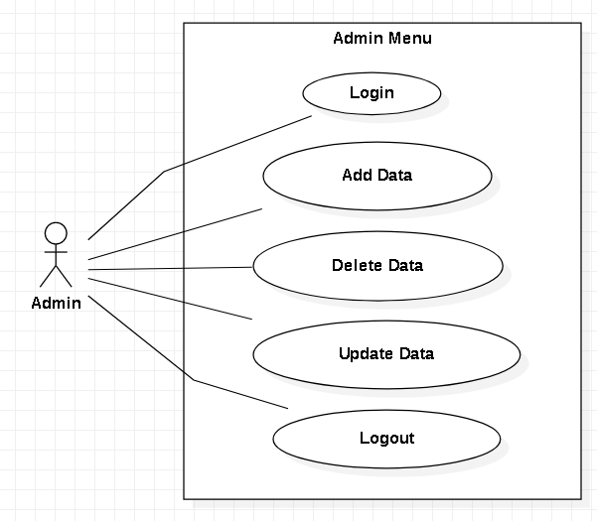
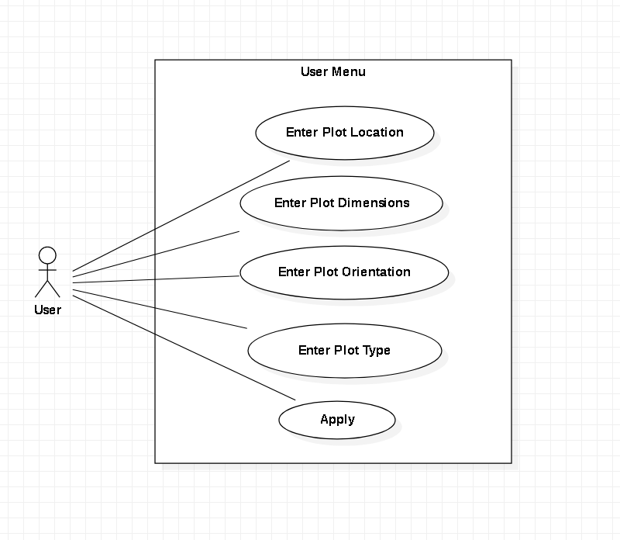
Use case Diagrams:

Slide 11
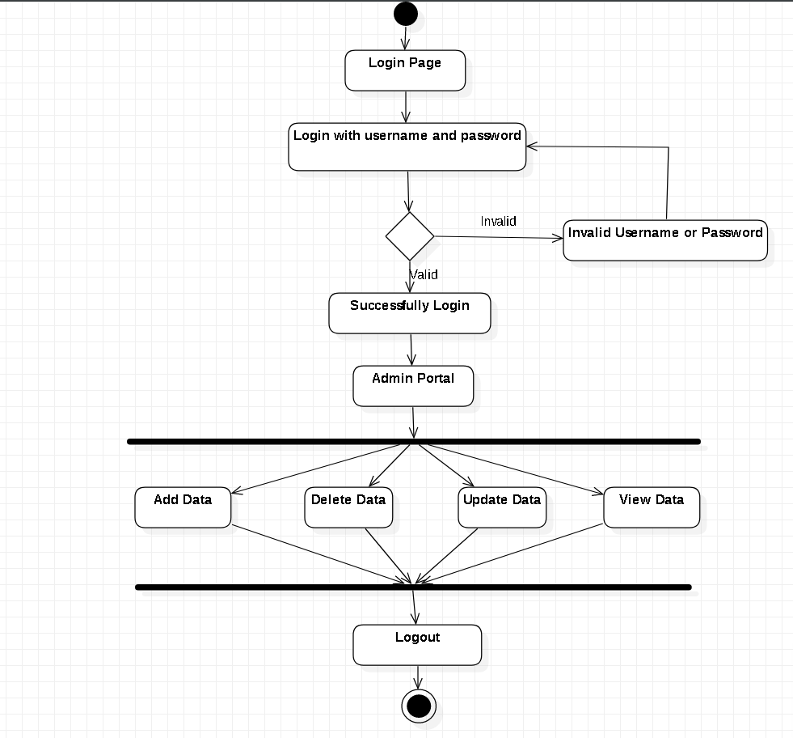
Activity Diagram (For Admin):

Slide 12
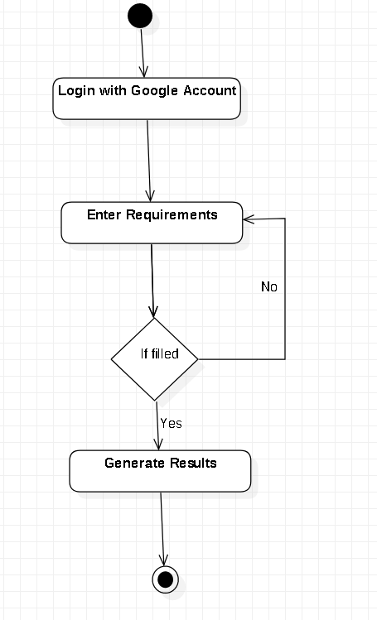
Activity Diagram(For User):

Slide 13
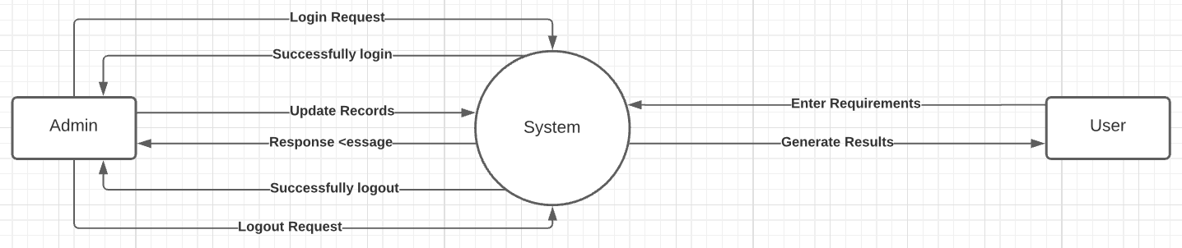
Data Flow Diagrams level 0

Slide 14
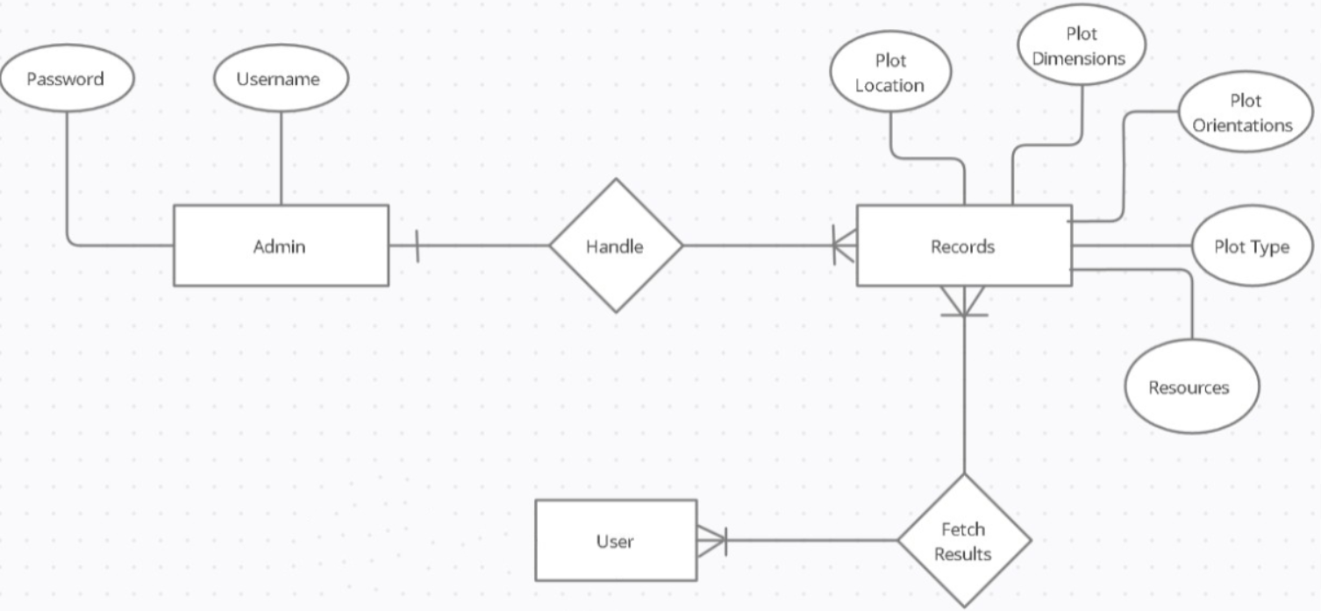
ER Diagram:

Slide 15
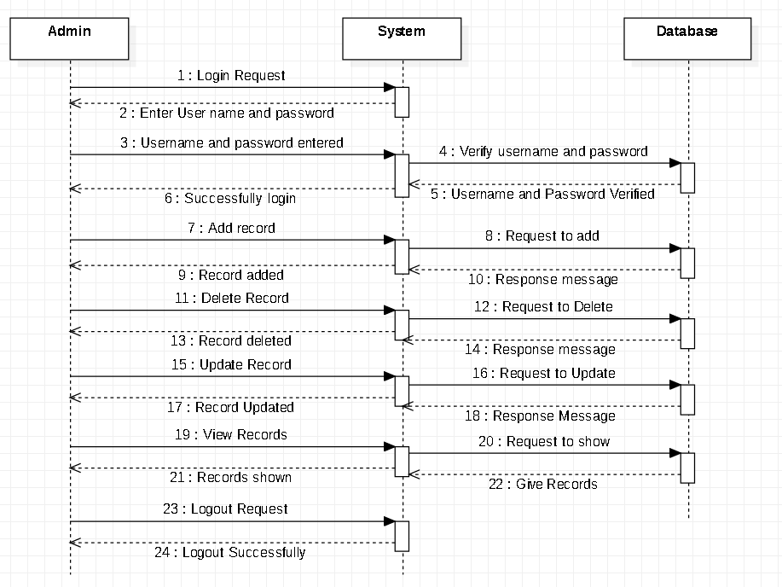
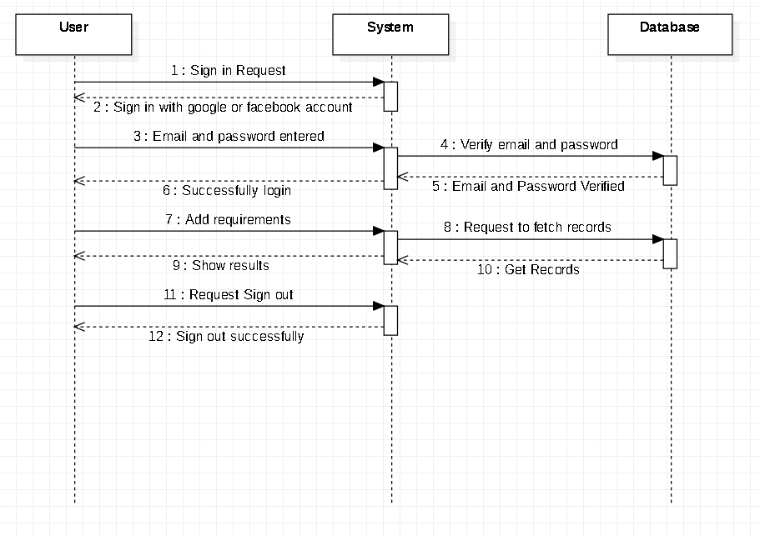
Sequence Diagrams:

Slide 16
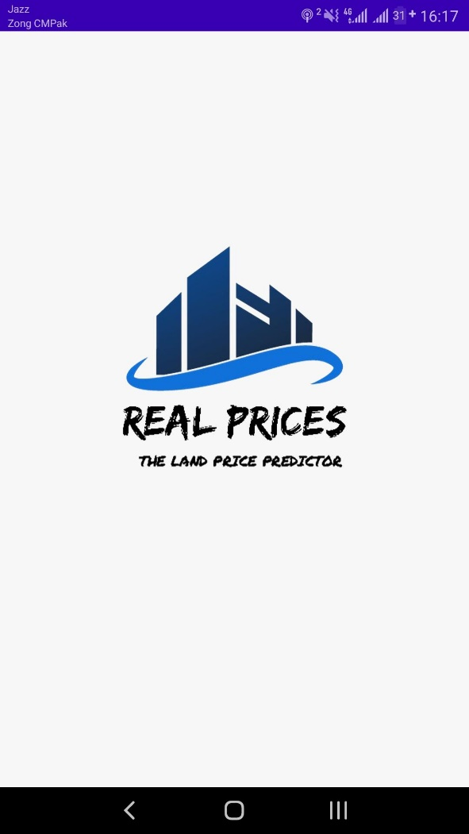
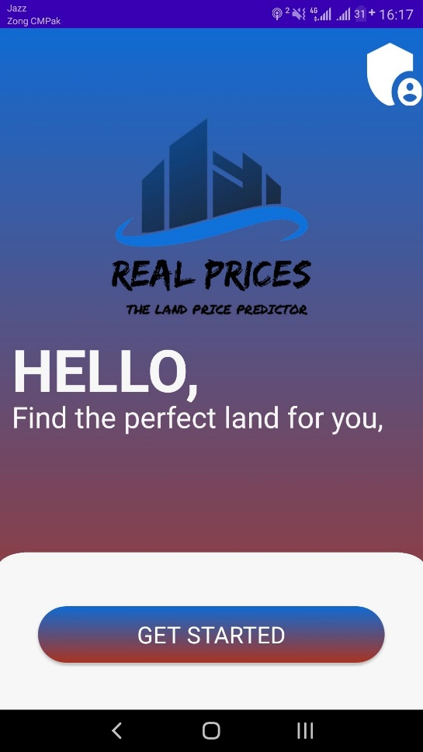
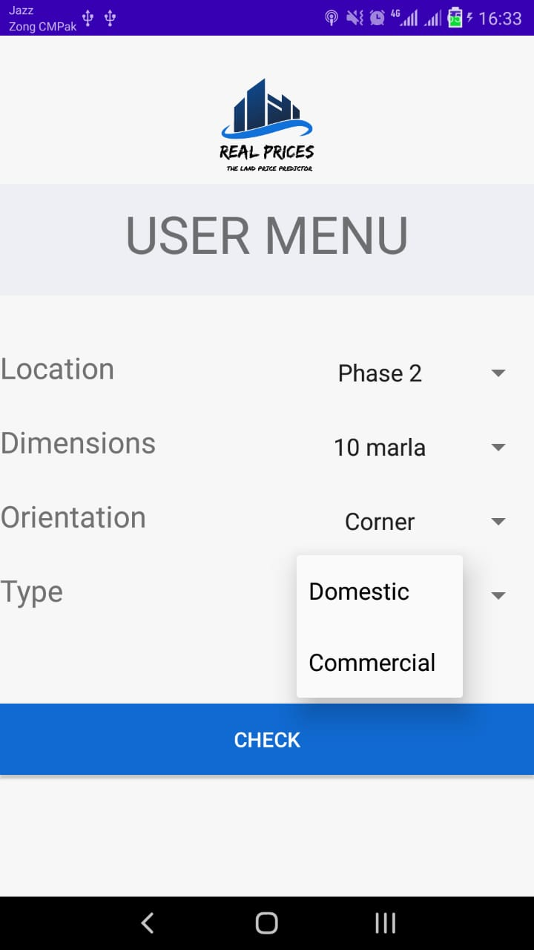
Application Screenshots

Slide 17
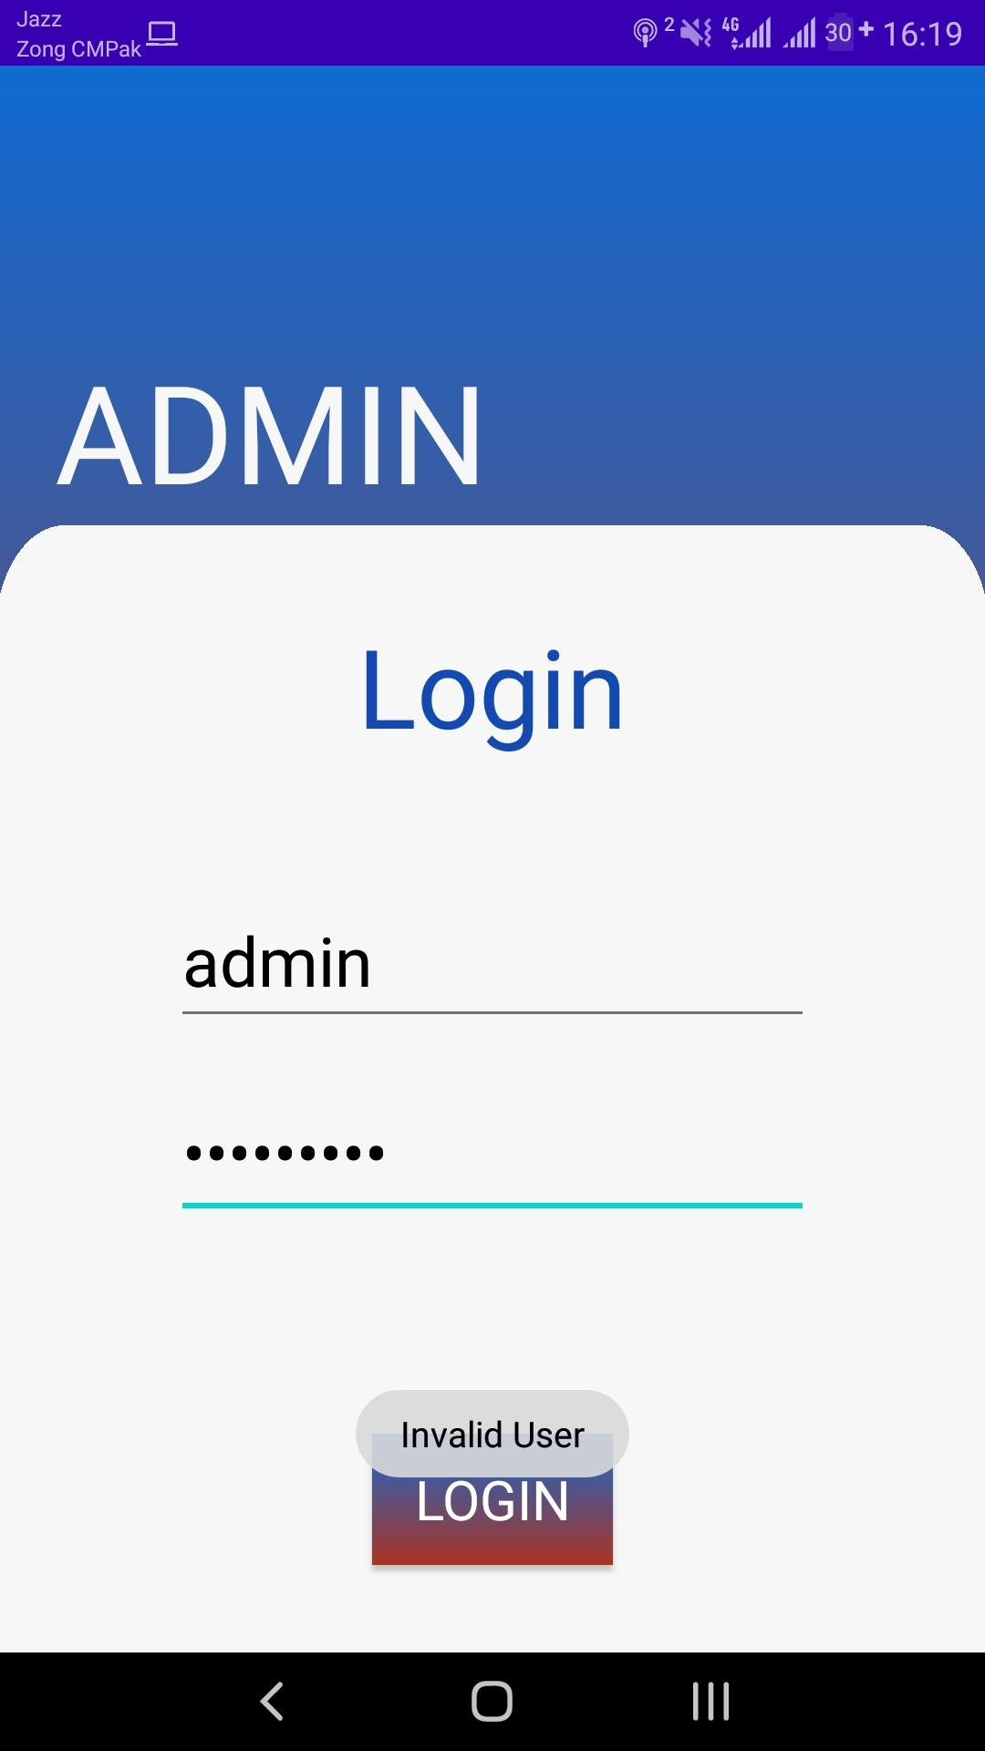
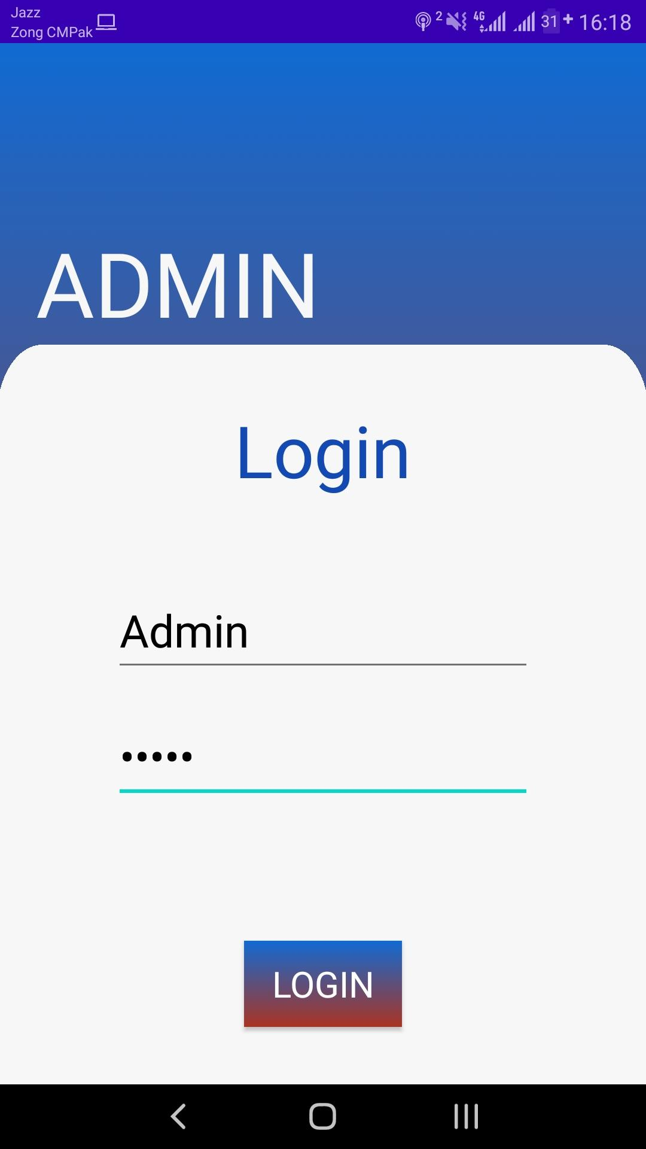
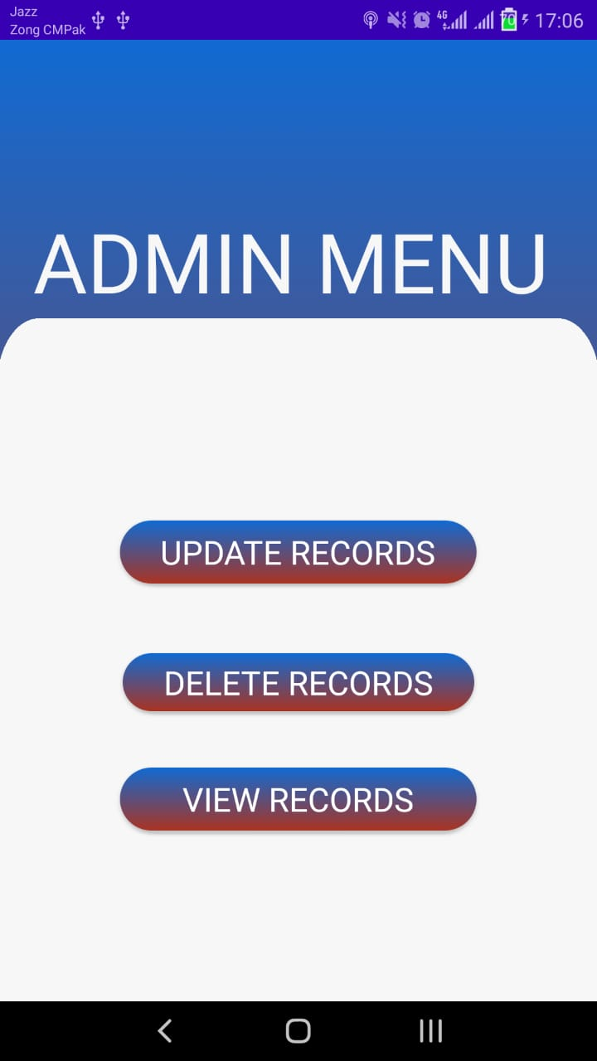

Slide 18
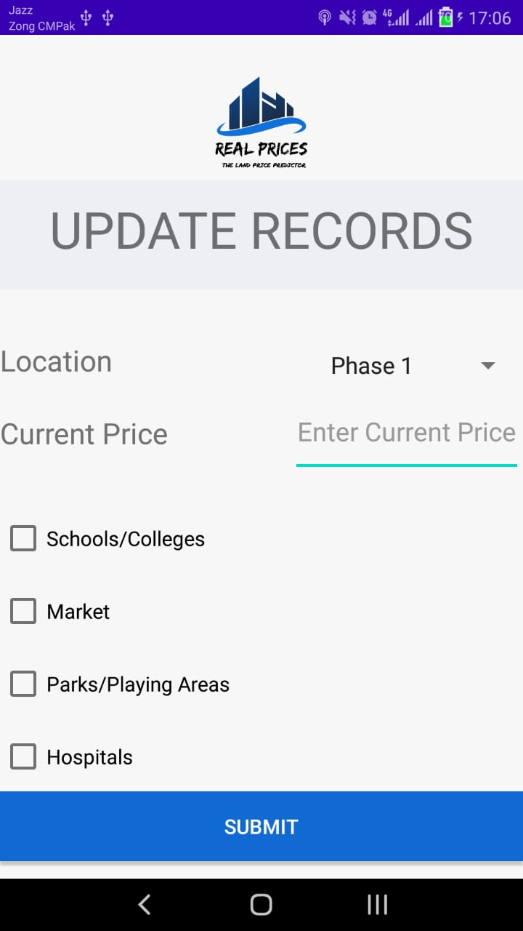
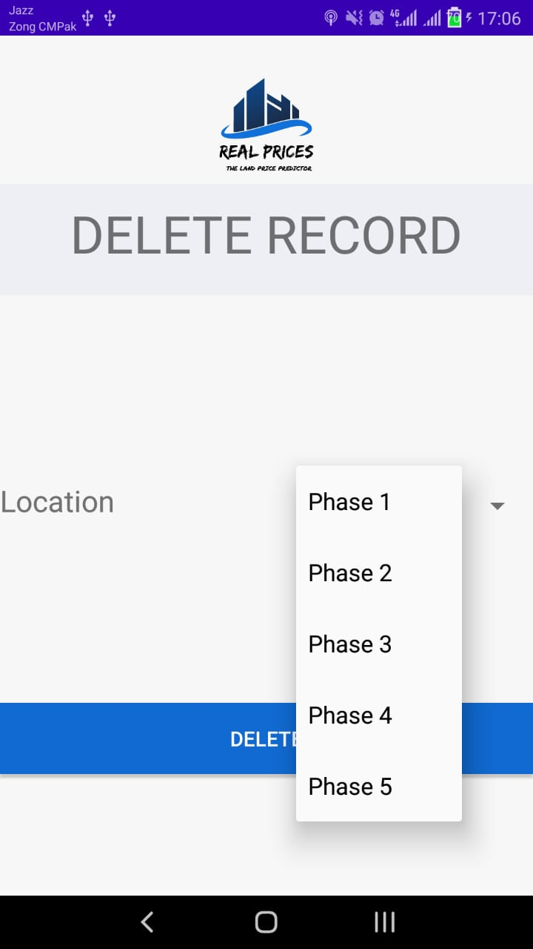


Slide 19
Conclusions
We have designed the interface of our application.
The admin’s menu and its login system is almost designed, from which he will make changes in data set.
Currently we’re working on the backend of the system.
Also we’re finding the accurate data set for us. If we couldn’t find it we’ll make changes in the previous ones.
We are studying the algorithm that we’ll use in our system and finding the more precise and fast algorithm for this purpose.

Slide 20
References
C. M. Bishop,Pattern Recognition and Machine Learning. Springer, 2006.
K. P. Murphy,Machine Learning: A Probabilistic Perspective. MIT Press,2012.
S. J. Sheather, “Density Estimation,”Statistical Science, vol. 19, no. 4, pp.588–597, 2004.
B. W. Silverman,Density Estimation for Statistics and Data Analysis.CRC Press, 1986.
L. van der Maaten, E. Postma, and H. van den Herik, “DimensionalityReduction: A Comparative Review,”Elsevier, 2008.
C. J. C. Burges,Dimension Reduction: A Guided Tour. Now PublishersInc, 2010.
A. Jain, M. Murty, and P. Flynn, “Data Clustering: A Review,” 2009.
P. Dayan and C. J. Watkins, “Reinforcement Learning,” inEncyclopedia ofCognitive Science. MacMillan Press, 2001.
D. C. Montgomery, E. A. Peck, and G. G. Vining,Introduction to LinearRegression Analysis. John Wiley and Sons, 2012.
I. J. Myung, “Tutorial on maximum likelihood estimation,”Elsevier Sci-ence, 2003.
D. Lindley and A. Smith, “Bayes Estimates for the Linear Model,”Journalof the Royal Statistical Society, vol. 34, no. 1, pp. 1–41, 1972.

